Slide 1

Database Management System (DBMS)
(Course code: 22CS****R)
CO# 1 ,Session# 2:
Session Topic: Database Architecture

Slide 2
Session Objective
Students should be able to understand
The database architecture
The database users

Slide 3
Poll Question-01
Q: Which of the following is a function of the DBMS?
A) Storing data
B) Providing multi-users access control
C) Data Integrity
D) All of the above

Slide 4
Answer: D
Explanation: The purpose of creating DBMS was to store the data. The data stored in the database management system can be can accessed by multiple users if the access is provided. The data stored will be accurate and complete hence providing data integrity.

Slide 5
Key Concepts
Database Environment
Typical DBMS Functionality
Database Users
Database Architecture

Slide 6

Database system environment

Slide 7
Database System Environment Contd…
Database system refers to an organization of components that defines and regulate the following:
Collection
Storage
Management
Use of data within the environment

Slide 8
Database System Environment Contd…
The Database System involves the following components:
  Hardware
  Software
  People
  Procedure
  Data.

Slide 9
Typical DBMS Functionality
Define a particular database in terms of its data types, structures, and constraints
Construct or Load the initial database contents on a secondary storage medium
Manipulating the database:
  Retrieval: Querying, generating reports
  Modification: Insertions, deletions and updates to its content
  Accessing the database through Web applications
Processing and Sharing by a set of concurrent users and application programs – yet, keeping all data valid and consistent

Slide 10
Typical DBMS Functionality
Other features:
  Protection or Security measures to prevent unauthorized access
  “Active” processing to take internal actions on data
  Presentation and Visualization of data
  Maintaining the database and associated programs over the lifetime of the database application
    Called database, software, and system maintenance

Slide 11
Example of a Database
(with a Conceptual Data Model)
Mini-world for the example:
  Part of a UNIVERSITY environment.
Some mini-world entities:
  STUDENTs
  COURSEs
  SECTIONs (of COURSEs)
  (academic) DEPARTMENTs
  INSTRUCTORs

Slide 12
Example of a Database
(with a Conceptual Data Model)
Some mini-world relationships:
  SECTIONs are of specific COURSEs
  STUDENTs take SECTIONs
  COURSEs have prerequisite COURSEs
  INSTRUCTORs teach SECTIONs
  COURSEs are offered by DEPARTMENTs
  STUDENTs major in DEPARTMENTs
Note: The above entities and relationships are typically expressed in a conceptual data model, such as the ENTITY-RELATIONSHIP data model (see Chapters 3, 4)

Slide 13

Example of a simple database

Slide 14
Main Characteristics of the Database Approach
Self-describing nature of a database system:
  A DBMS catalog stores the description of a particular database (e.g. data structures, types, and constraints)
  The description is called meta-data.
  This allows the DBMS software to work with different database applications.
Insulation between programs and data:
  Called program-data independence.
  Allows changing data structures and storage organization without having to change the DBMS access programs.

Slide 15

Example of a simplified database catalog

Slide 16
Main Characteristics of the Database Approach (continued)
Data Abstraction:
  A data model is used to hide storage details and present the users with a conceptual view of the database.
  Programs refer to the data model constructs rather than data storage details
Support of multiple views of the data:
  Each user may see a different view of the database, which describes only the data of interest to that user.

Slide 17
Main Characteristics of the Database Approach (continued)
Sharing of data and multi-user transaction processing:
  Allowing a set of concurrent users to retrieve from and to update the database.
  Concurrency control within the DBMS guarantees that each transaction is correctly executed or aborted
  Recovery subsystem ensures each completed transaction has its effect permanently recorded in the database
  OLTP (Online Transaction Processing) is a major part of database applications. This allows hundreds of concurrent transactions to execute per second.

Slide 18
Database Users
Users may be divided into
  Those who actually use and control the database content, and those who design, develop and maintain database applications (called “Actors on the Scene”), and
  Those who design and develop the DBMS software and related tools, and the computer systems operators (called “Workers Behind the Scene”).

Slide 19

Database Users

Slide 20
Database Users
Actors on the scene
  Database administrators:
    Responsible for authorizing access to the database, for coordinating and monitoring its use, acquiring software and hardware resources, controlling its use and monitoring efficiency of operations.
  Database Designers:
    Responsible to define the content, the structure, the constraints, and functions or transactions against the database. They must communicate with the end-users and understand their needs.

Slide 21
Categories of End-users
Actors on the scene (continued)
  End-users: They use the data for queries, reports and some of them update the database content. End-users can be categorized into:
    Casual: access database occasionally when needed
    Naïve or Parametric: they make up a large section of the end-user population.
      They use previously well-defined functions in the form of “canned transactions” against the database.
      Examples are bank-tellers or reservation clerks who do this activity for an entire shift of operations.

Slide 22
Categories of End-users (continued)
    Sophisticated:
      These include business analysts, scientists, engineers, others thoroughly familiar with the system capabilities.
      Many use tools in the form of software packages that work closely with the stored database.
    Stand-alone:
      Mostly maintain personal databases using ready-to-use packaged applications.
      An example is a tax program user that creates its own internal database.
      Another example is a user that maintains an address book

Slide 23
Database Administrator
A person who has central control over the system is called a database administrator (DBA). Functions of a DBA include:
Schema definition
Storage structure and access-method definition
Schema and physical-organization modification
Granting of authorization for data access
Routine maintenance
Periodically backing up the database
Ensuring that enough free disk space is available for normal operations, and upgrading disk space as required
Monitoring jobs running on the database

Slide 24
Database Architecture
Centralized databases
  One to a few cores, shared memory
Client-server,
  One server machine executes work on behalf of multiple client machines.
Parallel databases
  Many core shared memory
  Shared disk
  Shared nothing
Distributed databases
  Geographical distribution
  Schema/data heterogeneity

Slide 25
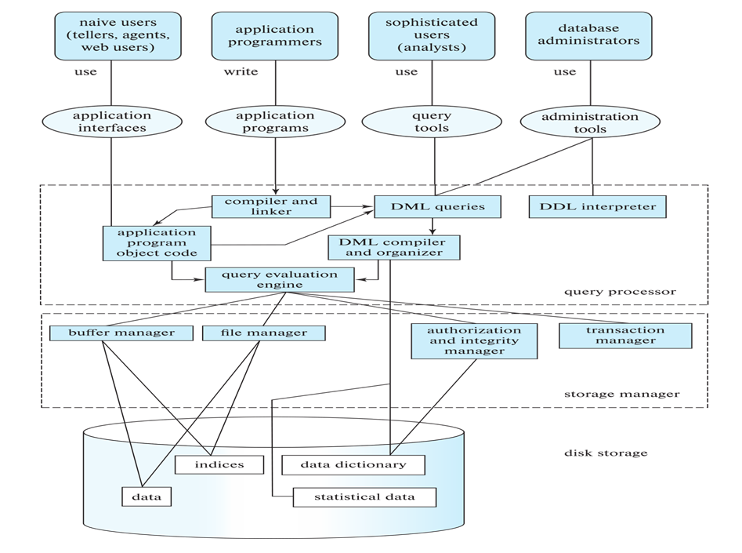
Database Architecture (Centralized/Shared-Memory)

Slide 28
Database Applications
Database applications are usually partitioned into two or three parts
Two-tier architecture -- the application resides at the client machine, where it invokes database system functionality at the server machine
Three-tier architecture -- the client machine acts as a front end and does not contain any direct database calls.
  The client end communicates with an application server, usually through a forms interface.
  The application server in turn communicates with a database system to access data.

Slide 29
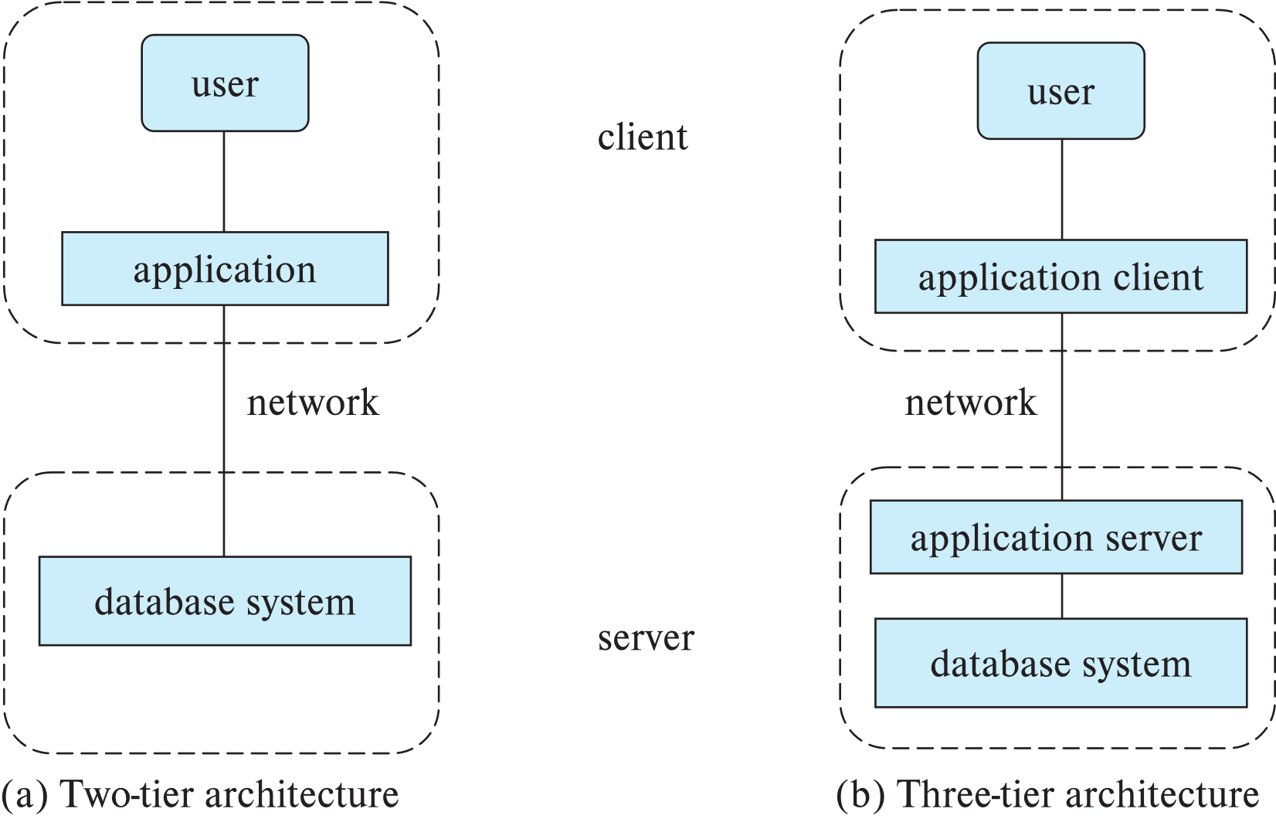
Two-tier and three-tier architectures

Slide 30
Advantages of Using the Database Approach
Controlling redundancy in data storage and in development and maintenance efforts.
  Sharing of data among multiple users.
Restricting unauthorized access to data.
Providing persistent storage for program Objects
  In Object-oriented DBMSs – see Chapters 20-22
Providing Storage Structures (e.g. indexes) for efficient Query Processing

Slide 31
Advantages of Using the Database Approach (continued)
Providing backup and recovery services.
Providing multiple interfaces to different classes of users.
Representing complex relationships among data.
Enforcing integrity constraints on the database.
Drawing inferences and actions from the stored data using deductive and active rules

Slide 32
Additional Implications of Using the Database Approach
Potential for enforcing standards:
  This is very crucial for the success of database applications in large organizations. Standards refer to data item names, display formats, screens, report structures, meta-data (description of data), Web page layouts, etc.
Reduced application development time:
  Incremental time to add each new application is reduced.

Slide 33
Additional Implications of Using the Database Approach (continued)
Flexibility to change data structures:
  Database structure may evolve as new requirements are defined.
Availability of current information:
  Extremely important for on-line transaction systems such as airline, hotel, car reservations.
Economies of scale:
  Wasteful overlap of resources and personnel can be avoided by consolidating data and applications across departments.

Slide 34
References
Database System Concepts, Sixth Edition, Abraham Silberschatz, Yale University Henry, F. Korth Lehigh University, S. Sudarshan Indian Institute of Technology, Bombay.
Fundamentals of Database Systems, 7th Edition, RamezElmasri, University of Texas at Arlington, Shamkant B. Navathe, University of Texas at Arlington.

